Slide 1
Car Cordapp Demo
By Alice

Slide 2



Problem Statement
Imagine you have bought a new car and you want to get it ready to hit the road
What would you need?
Road Tax
Car Insurance
MOT
Vehicle Owner
LTA
(Land Transport Authority)
Insurance Company
Garage

Slide 3
User Case Flow
5a. Request to issue TAX with payment, MOT and insurance
1. Negotiate on MOT test
2b. Issue MOT
5b. Validate and issue TAX
LTA
Vehicle Owner
Garage
2a. Perform actual MOT test
3. Negotiate on insurance
4c. Issue Insurance
Negotiate on MOT test deal
Issue MOT
Negotiate Insurance deal
Issue Insurance
Issue TAX
4b. Send payment and MOT
4a. Require payment and MOT
Insurance Company

Slide 4
User Case Flow
1. Negotiate on MOT test
LTA
Vehicle Owner
Garage
Negotiate on MOT test deal
Issue MOT
Negotiate Insurance deal
Issue Insurance
Issue TAX
Insurance Company
Notes:
Garage: authorized
Cash: origin

Slide 5
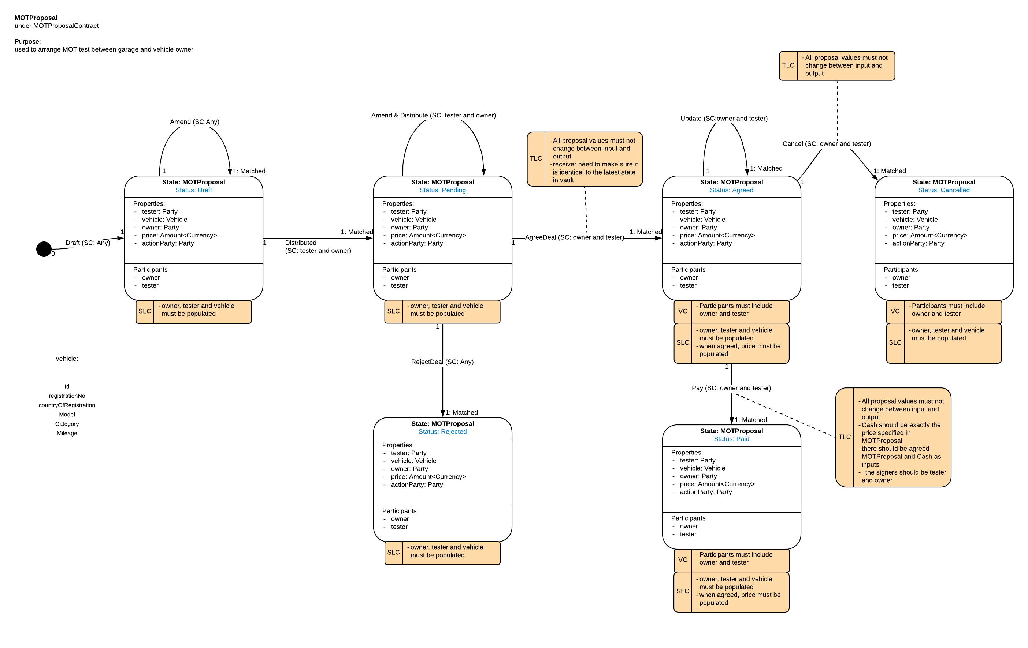
MOTProposal – State Machine
Vehicle Owner <-> Garage
Notes:
Status
ActionParty:
After a few rounds of exchanging proposals, when one party is trying to initiate a flow to reach to agreement, how could the other party make decision whether to accept or reject? Remember that human intervention is not allowed in responding flow. There could be a few options:
setting some hardcode threshold in responding flow -> lame, not feasible
actionParty/take actions in turns -> less flexibility
each party will record the last proposal they send out

Slide 6
User Case Flow
1. Negotiate on MOT test
2b. Issue MOT
LTA
Vehicle Owner
Garage
2a. Perform actual MOT test
Negotiate on MOT test deal
Issue MOT
Negotiate Insurance deal
Issue Insurance
Issue TAX
Insurance Company

Slide 7
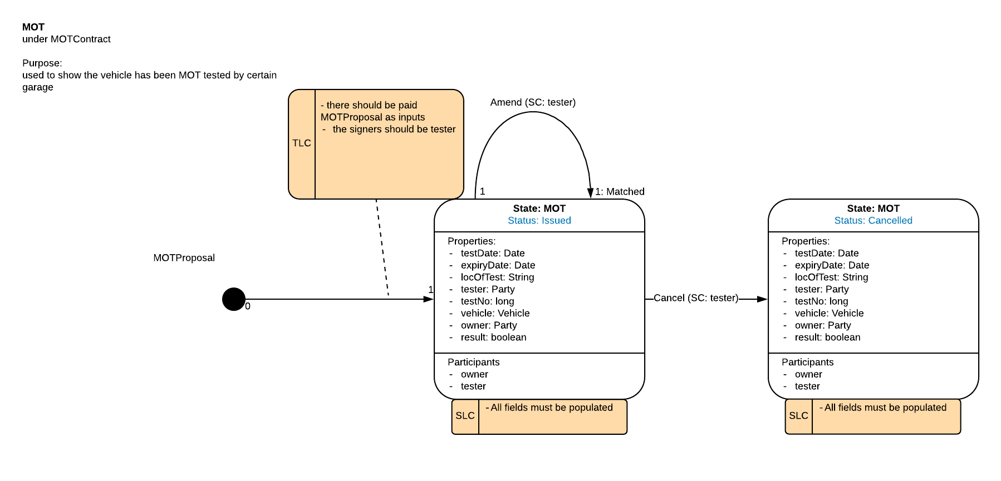
MOT – State Machine
Vehicle Owner <-> Garage

Slide 8
User Case Flow
1. Negotiate on MOT test
2b. Issue MOT
LTA
Vehicle Owner
Garage
2a. Perform actual MOT test
3. Negotiate on insurance
Negotiate on MOT test deal
Issue MOT
Negotiate Insurance deal
Issue Insurance
Issue TAX
Insurance Company

Slide 9
User Case Flow
1. Negotiate on MOT test
2b. Issue MOT
LTA
Vehicle Owner
Garage
2a. Perform actual MOT test
3. Negotiate on insurance
4c. Issue Insurance
Negotiate on MOT test deal
Issue MOT
Negotiate Insurance deal
Issue Insurance
Issue TAX
4b. Send payment and MOT
4a. Require payment and MOT
Insurance Company

Slide 10
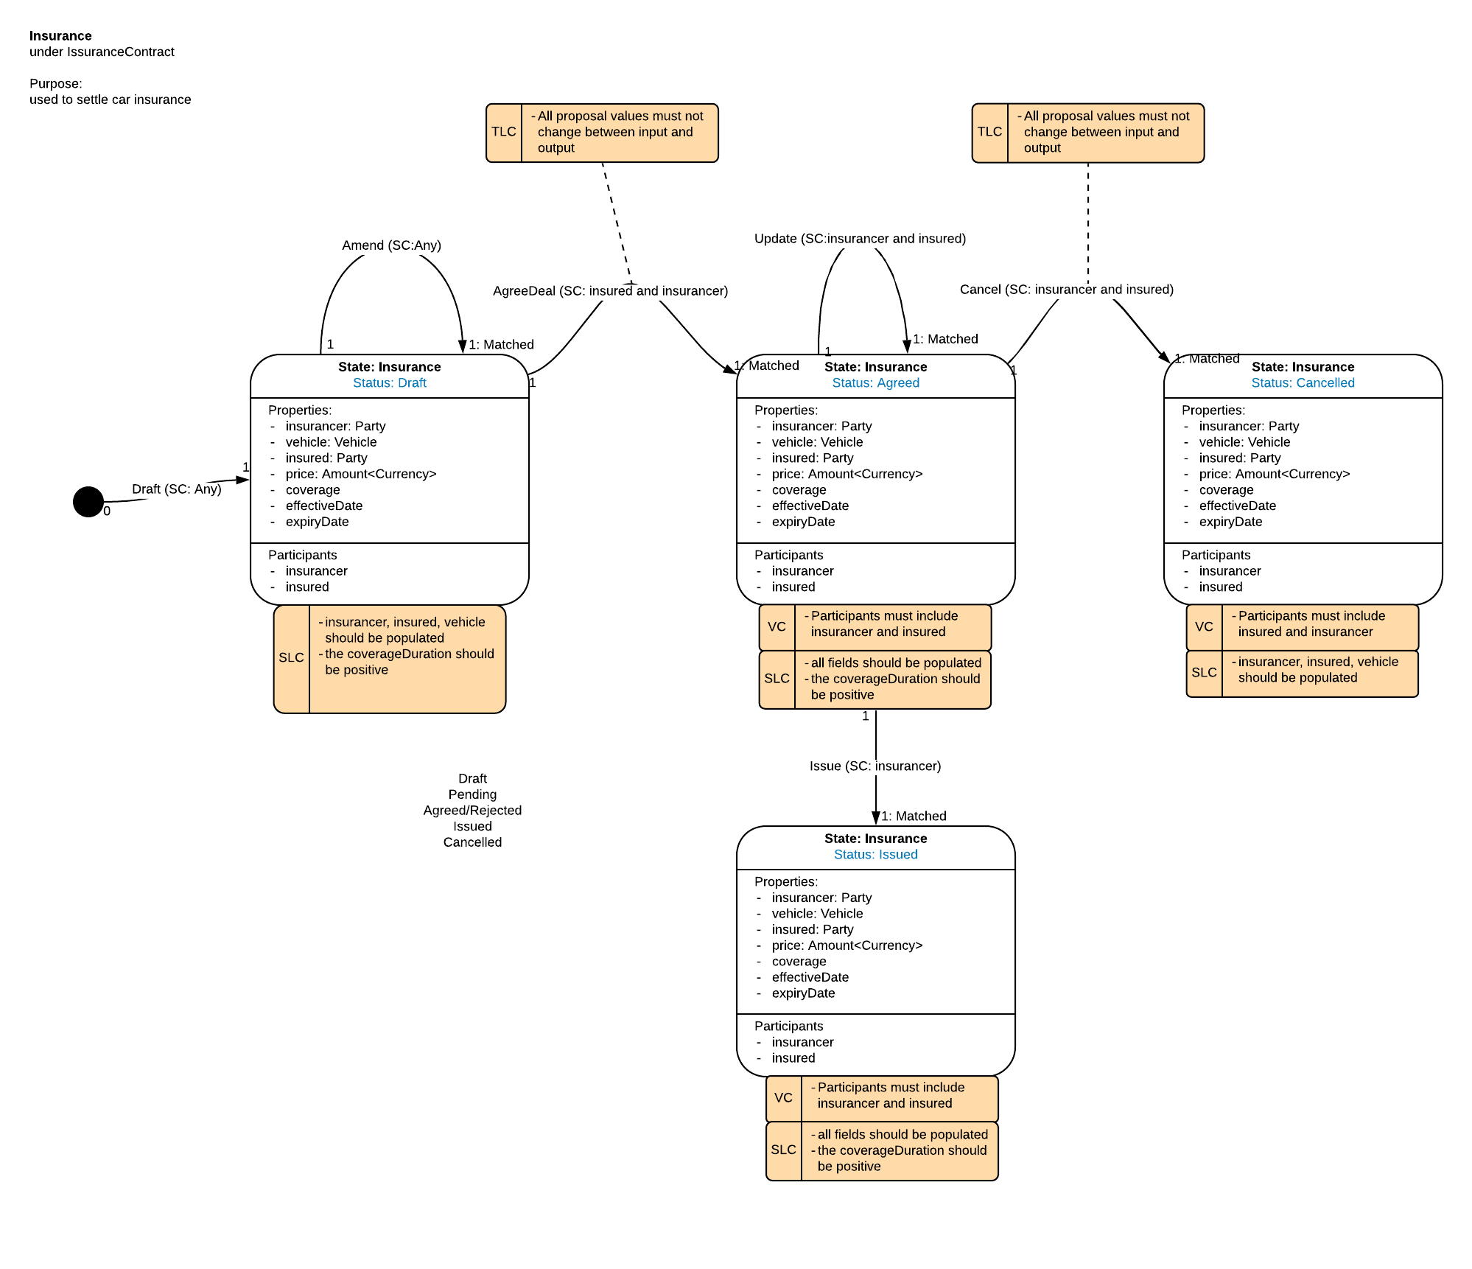
Insurance – State Machine
Vehicle Owner <-> Insurance Company

Slide 11
User Case Flow
5a. Request to issue TAX with payment, MOT and insurance
1. Negotiate on MOT test
2b. Issue MOT
5b. Validate and issue TAX
LTA
Vehicle Owner
Garage
2a. Perform actual MOT test
3. Negotiate on insurance
4c. Issue Insurance
Negotiate on MOT test deal
Issue MOT
Negotiate Insurance deal
Issue Insurance
Issue TAX
4b. Send payment and MOT
4a. Require payment and MOT
Insurance Company

Slide 12
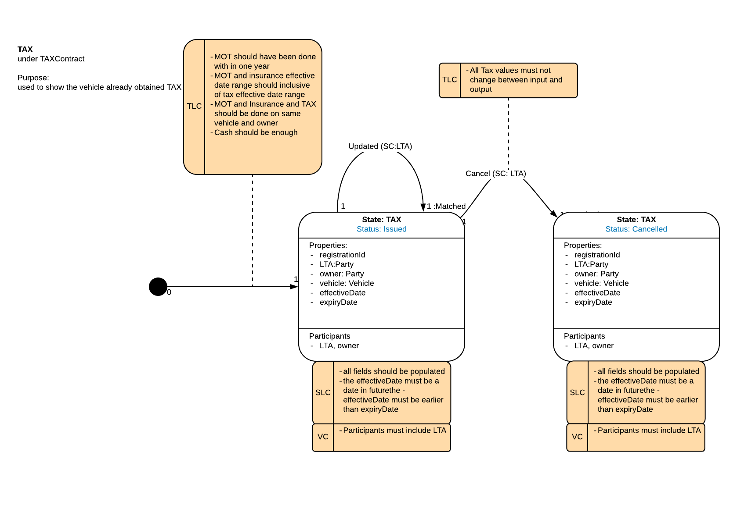
TAX – State Machine
Vehicle Owner <-> LTA

Slide 13
Privacy Analysis
If MOT and Insurance are directly referenced in later transactions, the participants in later transactions can resolve all previous MOT and Insurance transactions.
Privacy Analysis

Slide 14
Publish Pattern
Published pattern can be used when users want to involve some state as reference without revealing the historical chain behind it. A wrapper state of original state would be issued and used instead.
Publish vs. Revoke (when original state has changed)
Published state can be
Used as input
Used as reference

Slide 15
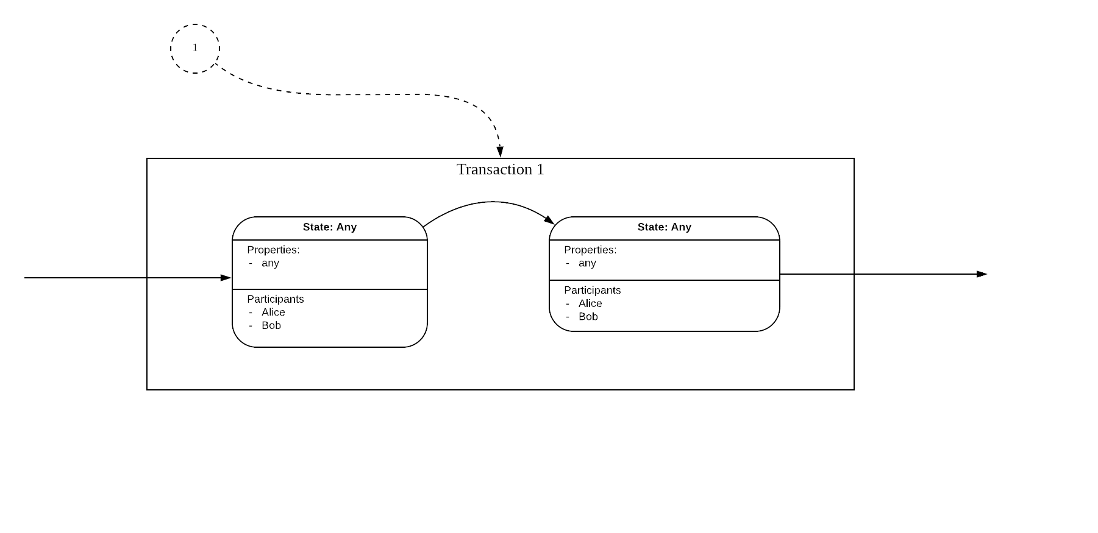
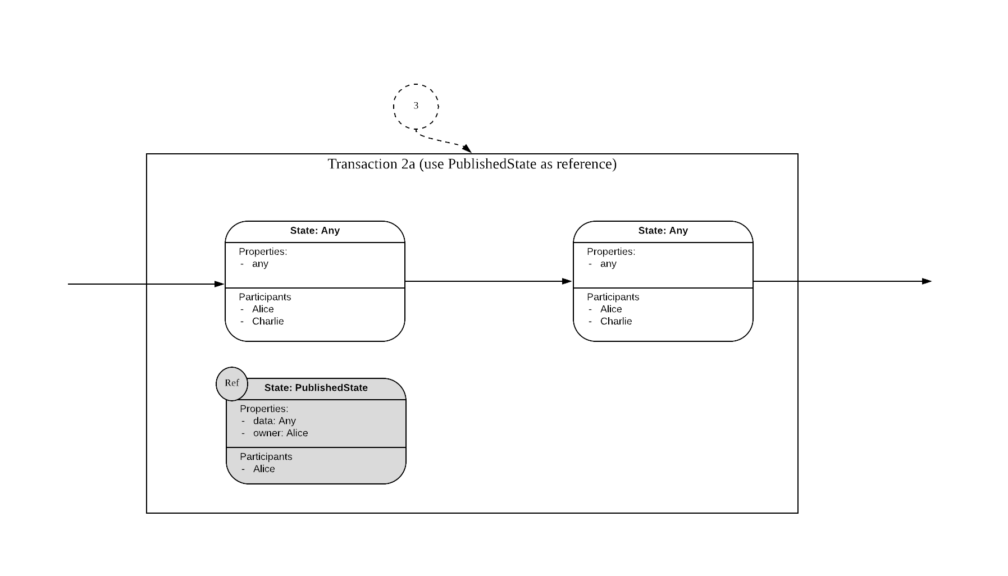
Flow Diagram - PublishStateFlow
the transaction which outputs the original state
the publish transaction proposed by Alice which issues the PublishedState without consuming any inputs
transaction 2a is a sample of using PublishedState as reference
transaction 2b is a sample of using PublishedState as input (used in this app)

Slide 16
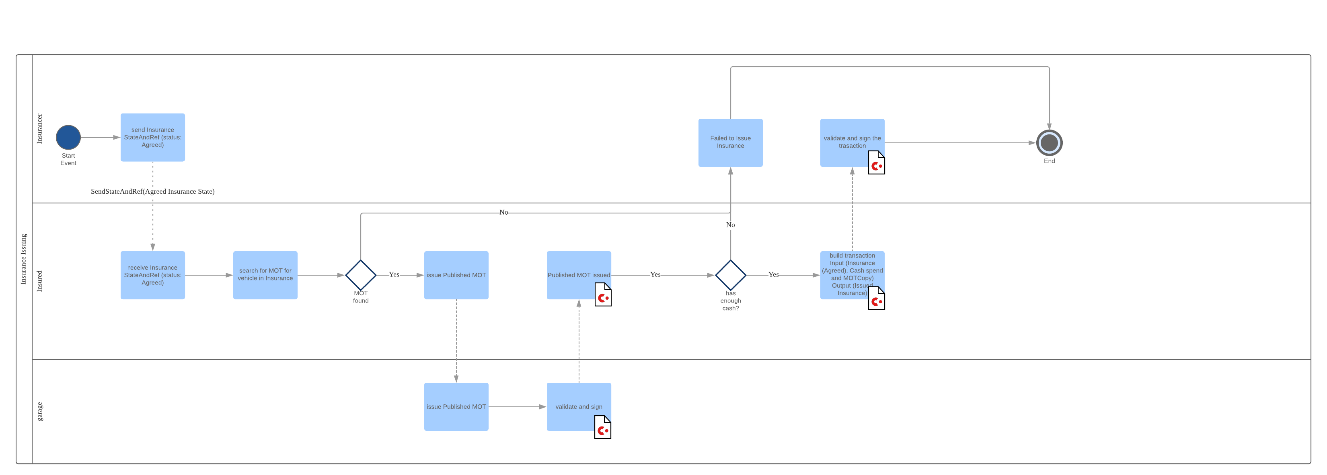
Flow Diagram – InsuranceIssueFlow
Flow Diagram – InsuranceIssueFlow
when Insurance company and vehicle owner has agreed on certain insurance detail, the next step is for the Insurance company to issue Insurance

Slide 17
Privacy Analysis - with Publish Pattern
Privacy Analysis
The participants in later transactions could only trace back to publish transactions, which is allowed for verification purposes.

Slide 18
User Case Flow – with Publish Pattern
5e. Request to issue TAX with payment, published MOT and published insurance
1. Negotiate on MOT test
2b. Issue MOT
5f. Validate and issue TAX
4b./5a. Publish MOT and sign
LTA
4c./5b. Validate and sign
Vehicle Owner
Garage
2a. Perform actual MOT test
3. Negotiate on insurance
4e. Issue Insurance
Negotiate on MOT test deal
Issue MOT
Negotiate Insurance deal
Issue Insurance
Issue TAX
5d. validate and sign
5c. Publish Insurance and sign
4a. Require payment and MOT
4d. Send payment and published MOT
Insurance Company

Slide 19
Demo with Kotlin shell
For more info on publish pattern, see https://github.com/corda/corda-solutions/blob/publisher-pattern/docs/source/design-patterns/patterns/publish.rst
CordApp repo: https://github.com/alicer3/car-cordapp.git

